Slide 1
Selenium

Slide 2
Selenium
Selenium is a free (open source) automated testing suite for web applications across different browsers and platforms.
It focuses on automating testing on web-based applications.
Testing done using Selenium tool is usually referred as Selenium Testing.
Selenium is not just a single tool but a suite of software, each catering to different testing needs of an organization.

Slide 3
It has four components:
Selenium Integrated Development Environment (IDE)
Selenium Remote Control (RC)
Selenium Grid
WebDriver

Slide 4
Selenium IDE
Selenium IDE is a complete integrated development environment (IDE) for Selenium tests.
It allows for recording, editing, and debugging of functional tests.
It was previously known as Selenium Recorder. Scripts may be automatically recorded and edited manually providing autocompletion support and the ability to move commands around quickly.
Scripts are recorded in Selenese, a special test scripting language for Selenium. Selenese provides commands for performing actions in a browser (click a link, select an option), and for retrieving data from the resulting pages.

Slide 5
Selenium RC
Selenium RC is the first automated web testing tool that allowed users to use a programming language they prefer.
RC makes it possible to write automated tests for a web application in any programming language, which allows for better integration of Selenium in existing unit test frameworks.
As of version 2.25.0, RC can support the following programming languages: Java, C#, PHP Python, Perl, Ruby.

Slide 6
Selenium Grid
Selenium Grid is a tool used together with Selenium RC to run parallel tests across different machines and different browsers all at the same time.
Parallel execution means running multiple tests at once.
It is a server that allows tests to use web browser instances running on remote machines.
With Selenium Grid, one server acts as the hub. It utilizes the hub-and-nodes concept. The hub acts as a central source of Selenium commands to each node connected to it.

Slide 7
WebDriver
WebDriver is a web automation framework that allows you to execute your tests against different browsers, not just Firefox, Chrome.
WebDriver enables you to use a programming language in creating your test scripts.
WebDriver’s goal is to supply a well-designed object-oriented API that provides improved support for modern advanced web-app testing problems.
Selenium-WebDriver makes direct calls to the browser using each browser’s native support for automation. How these direct calls are made, and the features they support depends on the browser you are using.
If your browser and tests will all run on the same machine, and your tests only use the WebDriver API, then you do not need to run the Selenium-Server; WebDriver will run the browser directly.
You can now use conditional operations like if-then-else or switch-case. You can also perform looping like do-while.
Programming languages supported by WebDriver are: Java, .Net, PHP, Python, Perl and Ruby.

Slide 8
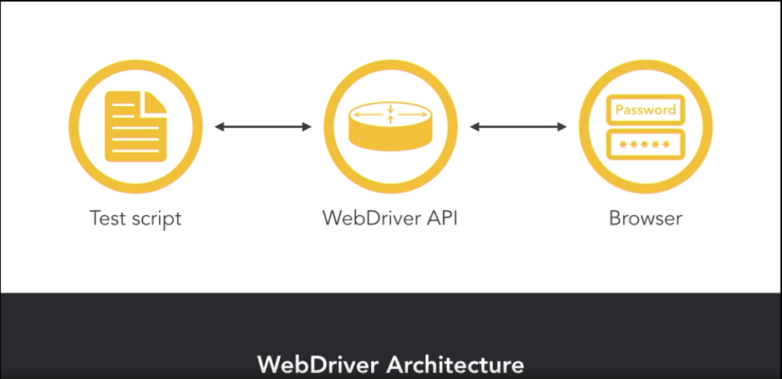
WebDriver Architecture
Selenium WebDriver works using client server communication.
When a Selenium test is executed, a new session of the browser is created, and the browser window is launched.
For each command in the test script a request is sent to the WebDriver API, which is a rest-based service.
The WebDriver API interprets the request and the step is then executed in the browser.
Once each step is complete, the response is sent back to the WebDriver API and then the test script. And this process continues until all steps are complete.
It supports all major programming languages such as: C, Java, Ruby, Python, and JavaScript.
Major platforms like macOS, Windows, and Linux. And also the browsers: Chrome, Firefox, and either Explorer or Edge, and Safari.

Slide 9
Selenium Locators
Selenium uses what is called locators to find and match the elements of your page that it needs to interact with. There are 8 locators strategies included in Selenium:
Identifier
Id
Name
Link
DOM
XPath
CSS
UI-element

Slide 10
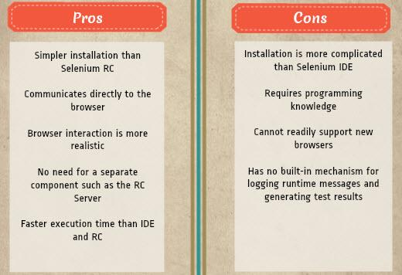
Pros and cons of selenium WebDriver:

Slide 11
Advantages of Selenium over UFT/QTP
Selenium | QTP
Open source, free to use, and free of charge. | Commercial.
Highly extensible | Limited add-ons
Can run tests across different browsers | Can only run tests in Firefox, Internet Explorer and Chrome
Supports various operating systems | Can only be used in Windows
Supports mobile devices | QTP Supports Mobile app test automation (iOS & Android) using HP solution called - HP Mobile Center
Can execute tests while the browser is minimized | Needs to have the application under test to be visible on the desktop
Can execute tests in parallel. | Can only execute in parallel but using Quality Center which is again a paid product.

Slide 12
What is Maven and why is it required?
Maven is a project management tool which encompasses a project object model, a set of standards, a project life cycle, a dependency management system, and logic for executing plugin goals at defined phases in a life cycle.
When you use Maven, you describe your project using a well-defined project object model, Maven can then apply cross-cutting logic from a set of shared (or custom) plugins.

Slide 13
Mainly Maven helps in following ways
Managing and enforcing a complete project life-cycle i.e. in-short Code compilation>Unit testing>Build generation (jar and war files)
So, here you can see a complete project management life cycle has been followed by Maven and if any of the one phase fails, Maven will not generate a build.
Easily managing external dependencies for the Java based project and keep the Java project light-weight (pom.xml)
Easily managing external dependencies for the Java based project: Maven team has placed all the Java based libraries on cloud, which you can easily download and integrate with your project by adding dependencies under <dependencies> tag in pom.xml file. You can find all the dependencies at following website: https://mvnrepository.com
In maven, you don't have to manage jar files manually. Instead of jar files, we use jar's dependencies in one configuration file called pom.xml.

Slide 14
POM.xml
A Project Object Model or POM is the fundamental unit of work in Maven.
It is an XML file that contains information about the project and configuration details used by Maven to build the project.
When executing a task or goal, Maven looks for the POM in the current directory.
It reads the POM, gets the needed configuration information, then executes the goal.

Slide 15
Example of dependencies in POM.xml
<dependencies>
<!-- https://mvnrepository.com/artifact/org.seleniumhq.selenium/selenium-java -->
<dependency>
<groupId>org.seleniumhq.selenium</groupId>
<artifactId>selenium-java</artifactId>
<version>3.141.59</version>
</dependency>
<!-- https://mvnrepository.com/artifact/junit/junit -->
<dependency>
<groupId>junit</groupId>
<artifactId>junit</artifactId>
<version>4.12</version>
<scope>test</scope>s
</dependency>
</dependencies>

Slide 16
Unit testing
Unit Testing is a level of software testing where individual units of software are tested.
A unit is the smallest testable part of software where usually few inputs are provided to test or verify a single functionality of a software system.
Unit testing confirms that whether the project is developing in right direction or not.
TestNG is an automation testing framework in which NG stands for "Next Generation". TestNG is inspired from JUnit which uses the annotations(@).
Using TestNG you can generate a proper report, and you can easily come to know how many test cases are passed, failed and skipped.

Slide 17
Important things to be Configured
JDK 1.8 should be downloaded and configured
Eclipse IDE should be downloaded
Maven should be downloaded and configured
Configure Selenium
Configure WebDriverManager
Purchase testNG in Eclipse using Help>>Install New Software>> http://dl.bintray.com/testng-team/testng-eclipse-release/>> click on TestNG

Slide 18
WebDriver Class Initiation
public class Signup {
public static WebDriver driver;
@BeforeTest
public void doInitial() {
WebDriverManager.chromedriver().setup();
driver = new ChromeDriver();
driver.get("https://www.gmail.com/");
driver.manage().window().maximize();
driver.manage().timeouts().implicitlyWait(10, TimeUnit.SECONDS);

Slide 19
Locators Usage
driver.findElement(By.xpath("//*[@id=\”identifierId\"])). sendKeys(r1s1);
driver.findElement(By.id("createAccountSubmit")).click();

Slide 20
To Add Excelsheet
File f = new File(”LOCATION");
FileInputStream fi = new FileInputStream(f);
Workbook workbook = WorkbookFactory.create(fi);
Sheet sheet1 = workbook.getSheetAt(1);
Row l1row1 = sheet1.getRow(1);
Cell r1login1 = l1row1.getCell(0);
String r1l1 = r1login1.toString();

Slide 21
TO Run Several Test In Sequence
@BeforeTest
public void doInitial() {
}
@Test(priority=1)
public void doSignup1() {. }
@Test(priority=2)
public void doSignup2() {. }

Slide 22
To declare a Negative Case
SoftAssert sa2 = new SoftAssert();
.
.
.
sa2.assertAll();

Slide 23
Automatic Reports

Slide 24
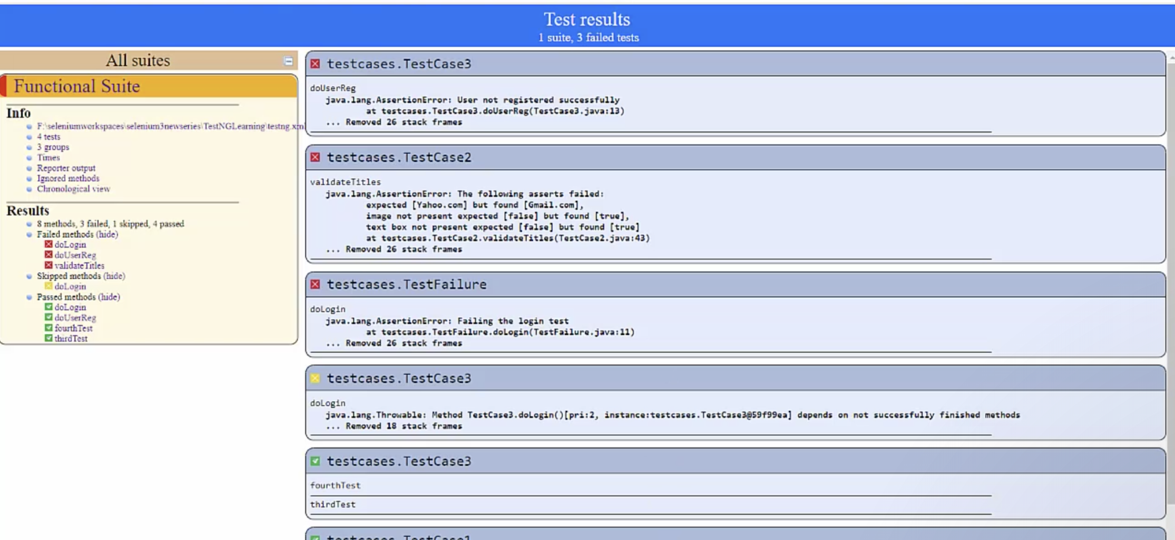

Slide 25
Expectation for Report [NOTE : Just for Reference with null test case run, Actual report would look different as per configuration ]

Slide 26
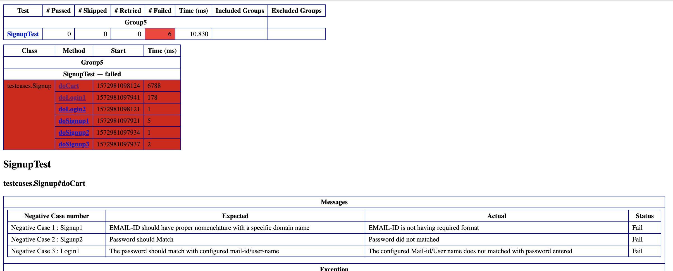

Slide 27
Useful Links..!!
How to download and install Selenium Webdriver:
https://www.guru99.com/installing-selenium-webdriver.html
selenium with Jenkins, maven and testng:
https://www.guru99.com/maven-jenkins-with-selenium-complete-tutorial.html
testng tutorial: https://www.guru99.com/all-about-testng-and-selenium.html
selenium with junit: https://www.softwaretestinghelp.com/selenium-junit-framework-selenium-tutorial-11/

